Slide 1





Soil texture alters drought response in Pinus edulis
Maria Teresa Hernandez, Amy V. Whipple, Chase J. Bebo, Steven Chischilly, Ryan Samuel A. Data, Catherine A. Gehring, Dalyna L. Hannah, Paul L. Heinrich, Ehren Reid Von Moler
Northern Arizona University
Biological Sciences
Navajo Technical University
Natural Resources

Slide 2
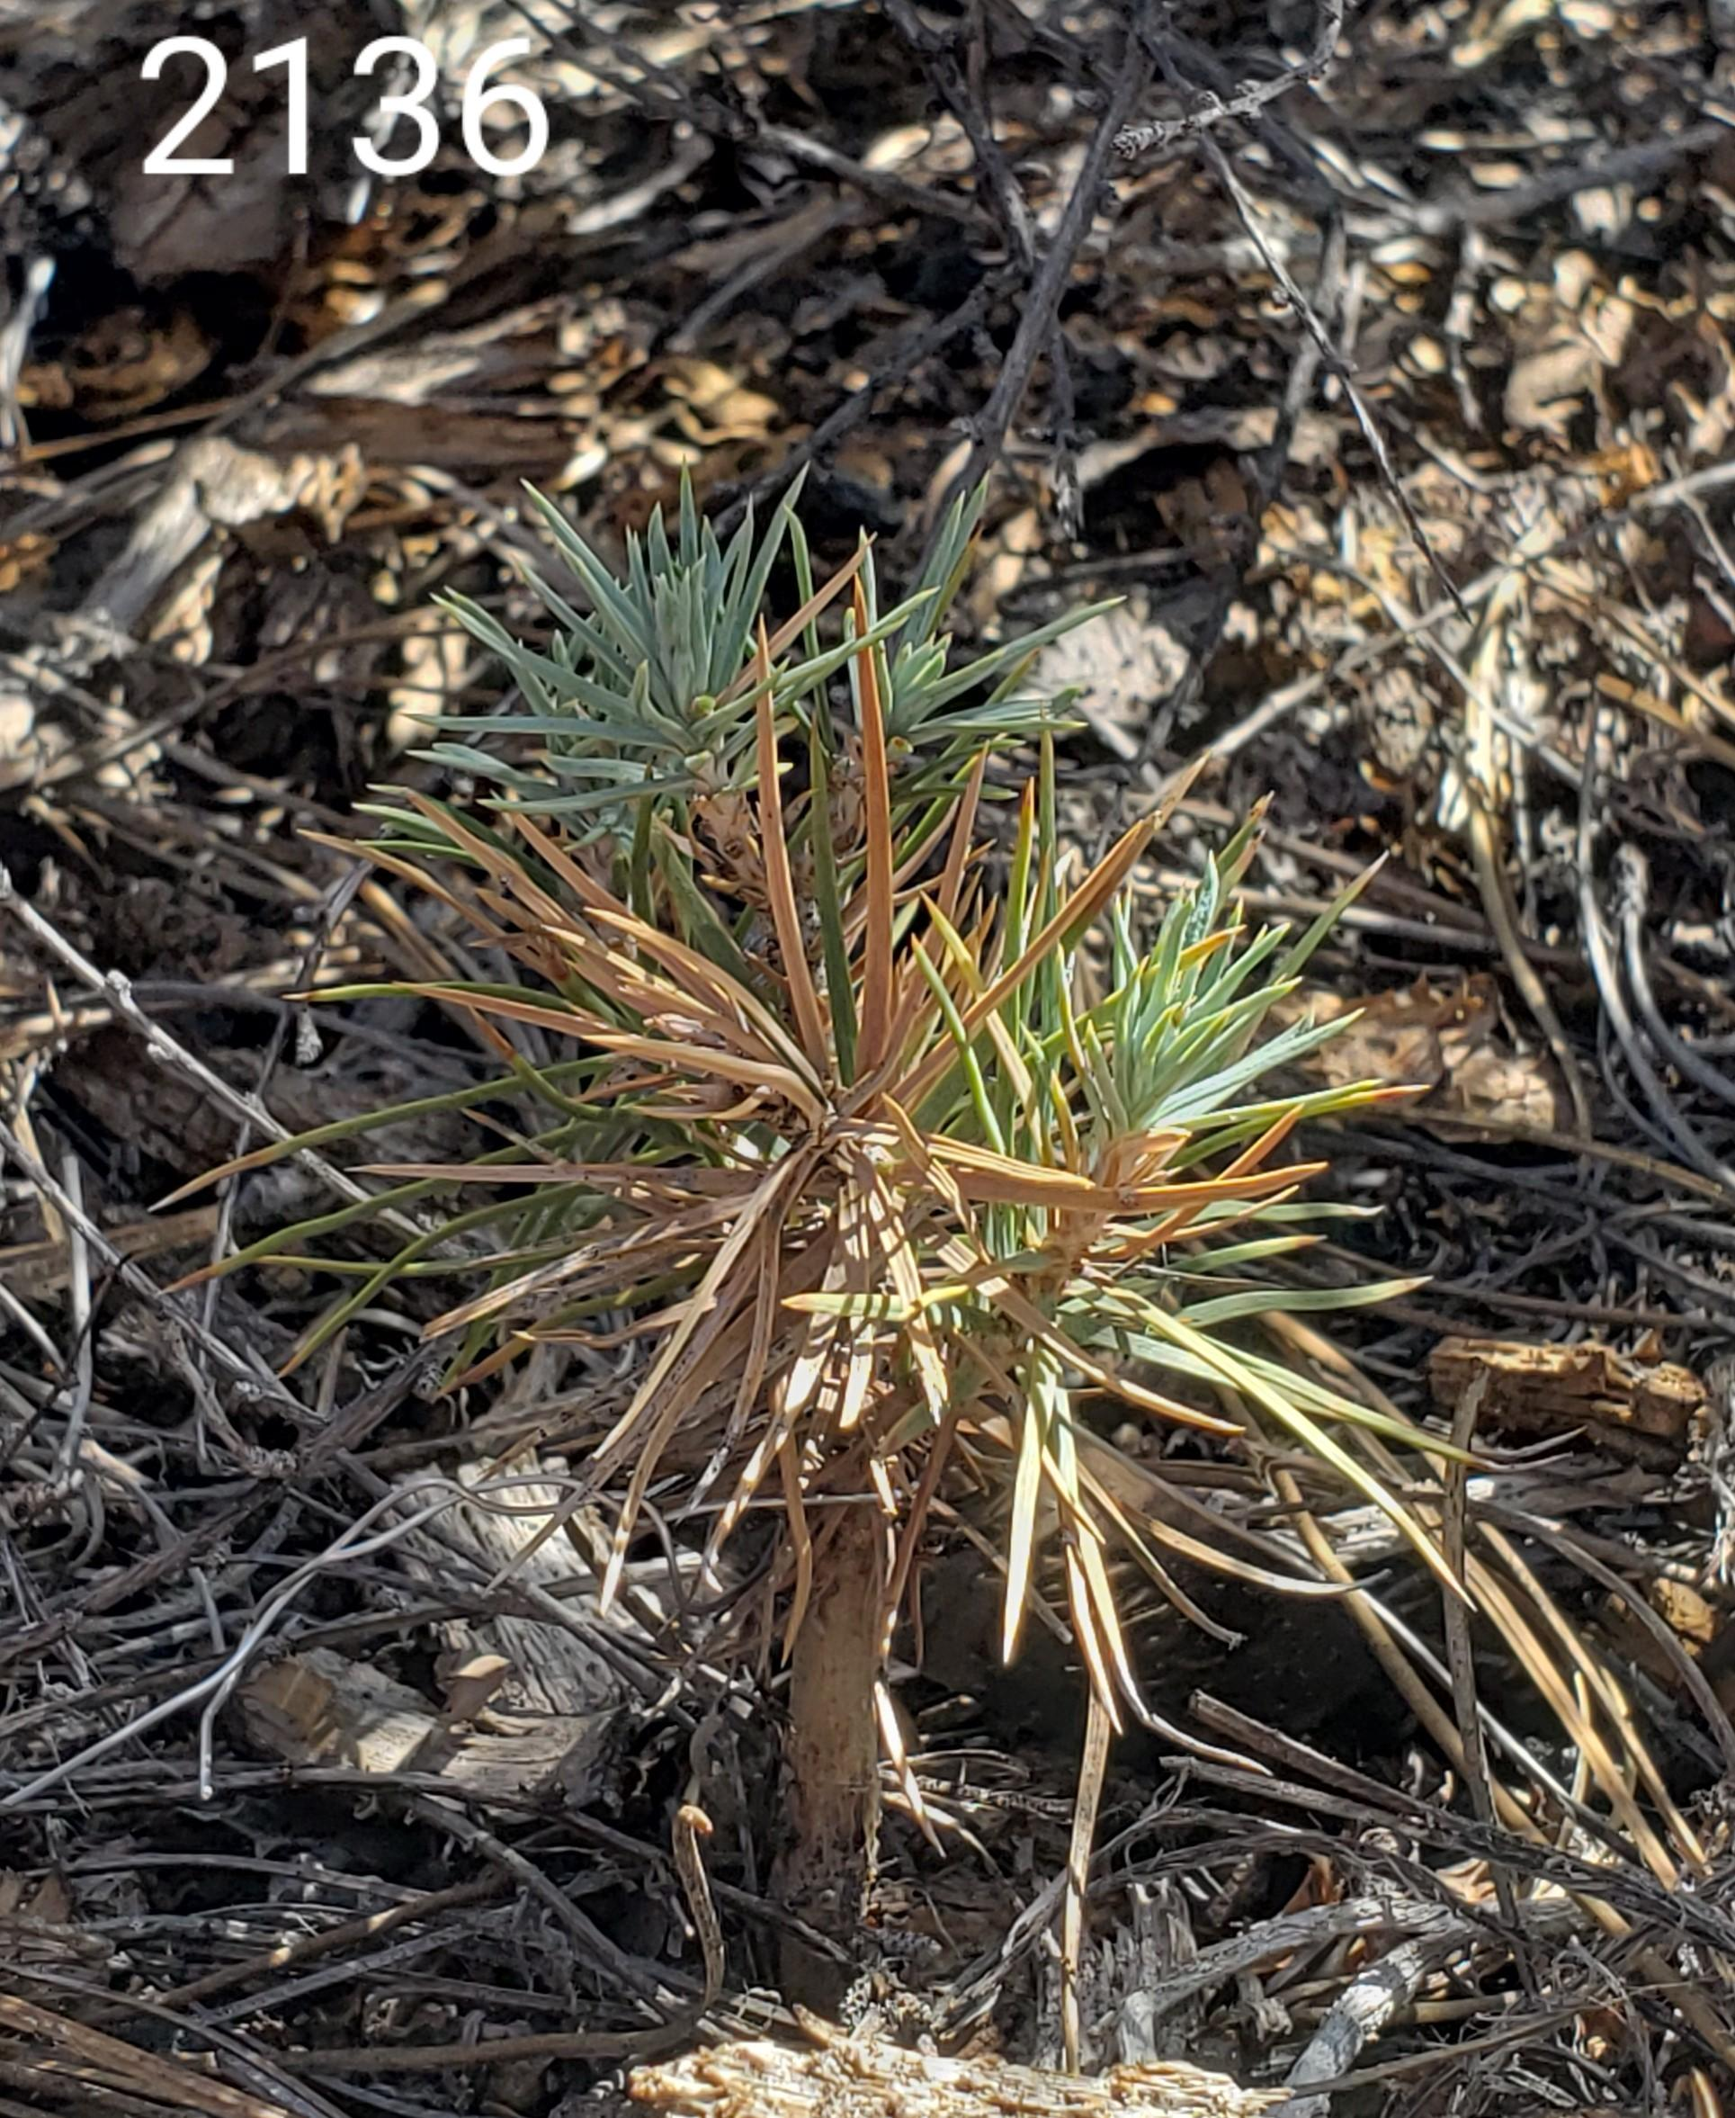
Soil, drought, and, climate change: What we know. Why is it important? What we hypothesized.
Climate change is increasing the severity of droughts.
    Droughts are becoming more frequent and longer in duration.
    Mortality of Pinus edulis is increasing for mature trees
Maintaining species diversity and managing a drought impacted
Pinyon-Juniper Woodland
    Pinyon-Juniper Woodland health can be estimated by assessing
    pinyon pines, which are negatively affected by drought.
Image taken in the field.
We hypothesize that soil texture impacts growth and survival in dry conditions for Pinus edulis.
Notes:
Hypothesis → change into; we hypothesis that soil texture impacts growth and survival in dry conditions.

Slide 3
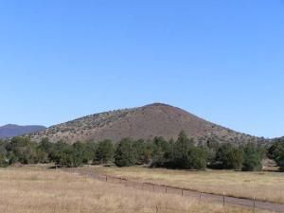
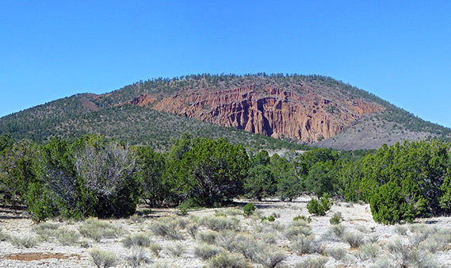
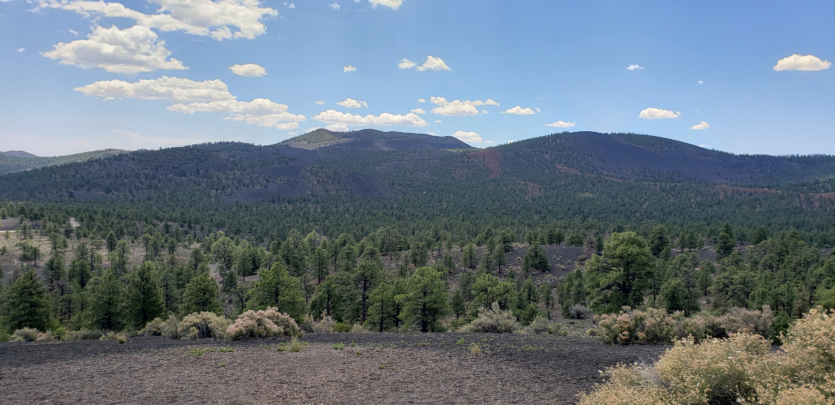
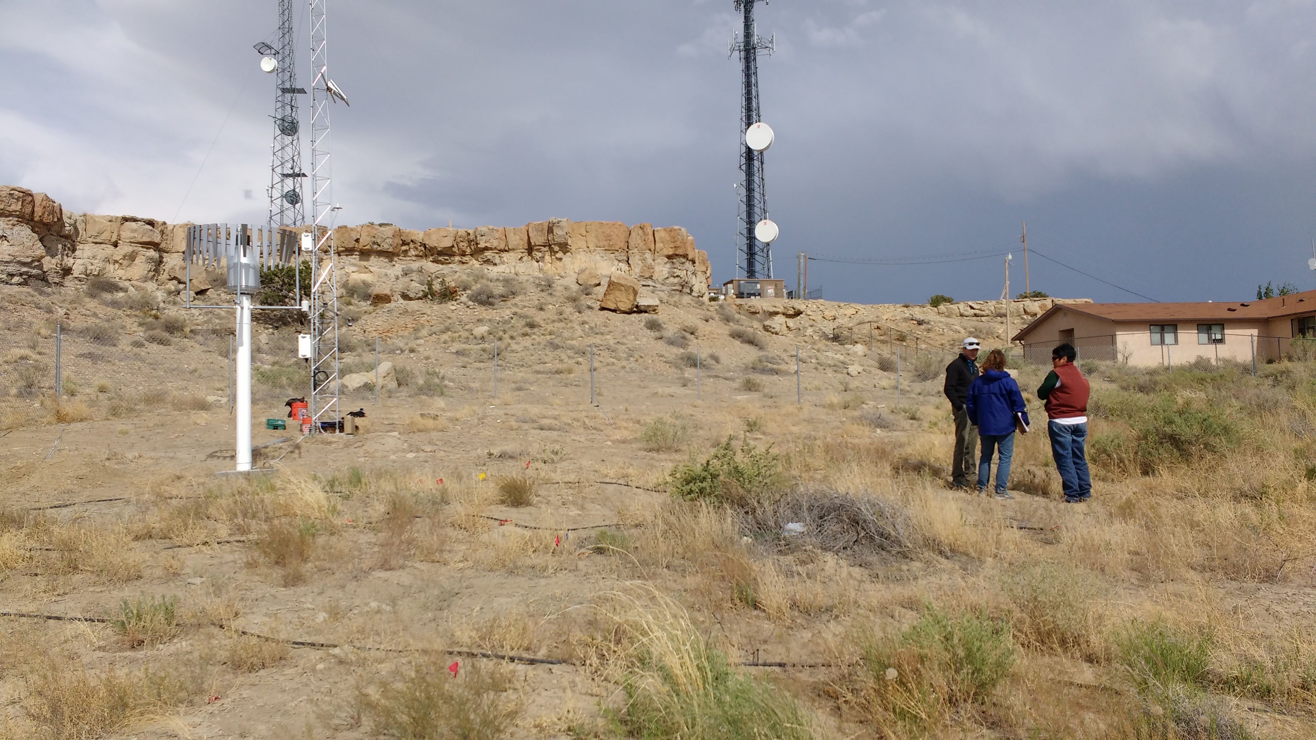
Collecting Seeds from Study Sites with different soil types to see if trees differ genetically
Pinyon seeds were collected from cinder fields and other sandy-clay loam soils in Northern Arizona.
Cinder field
Non-cinder site
Sunset Crater, AZ
Cinder Field
Sandy soil, NM
Notes:
Broaden NTU stuff. Cinder fields and other sandy to clay loam soils of Northern Az and Norther New Mexico. Remove Area1 call it sunset crater.
Examples of other sites remove name and say example of non cinder sites
Common gardens measurements were taken at cinder sites and label NTU as sandy in New Mexico, Amy will provide a picture for NTU.
Add a slide of taking measurements at the gardens after slide 3 then go into growth chamber stuff. Call slide common garden experiment.

Slide 4
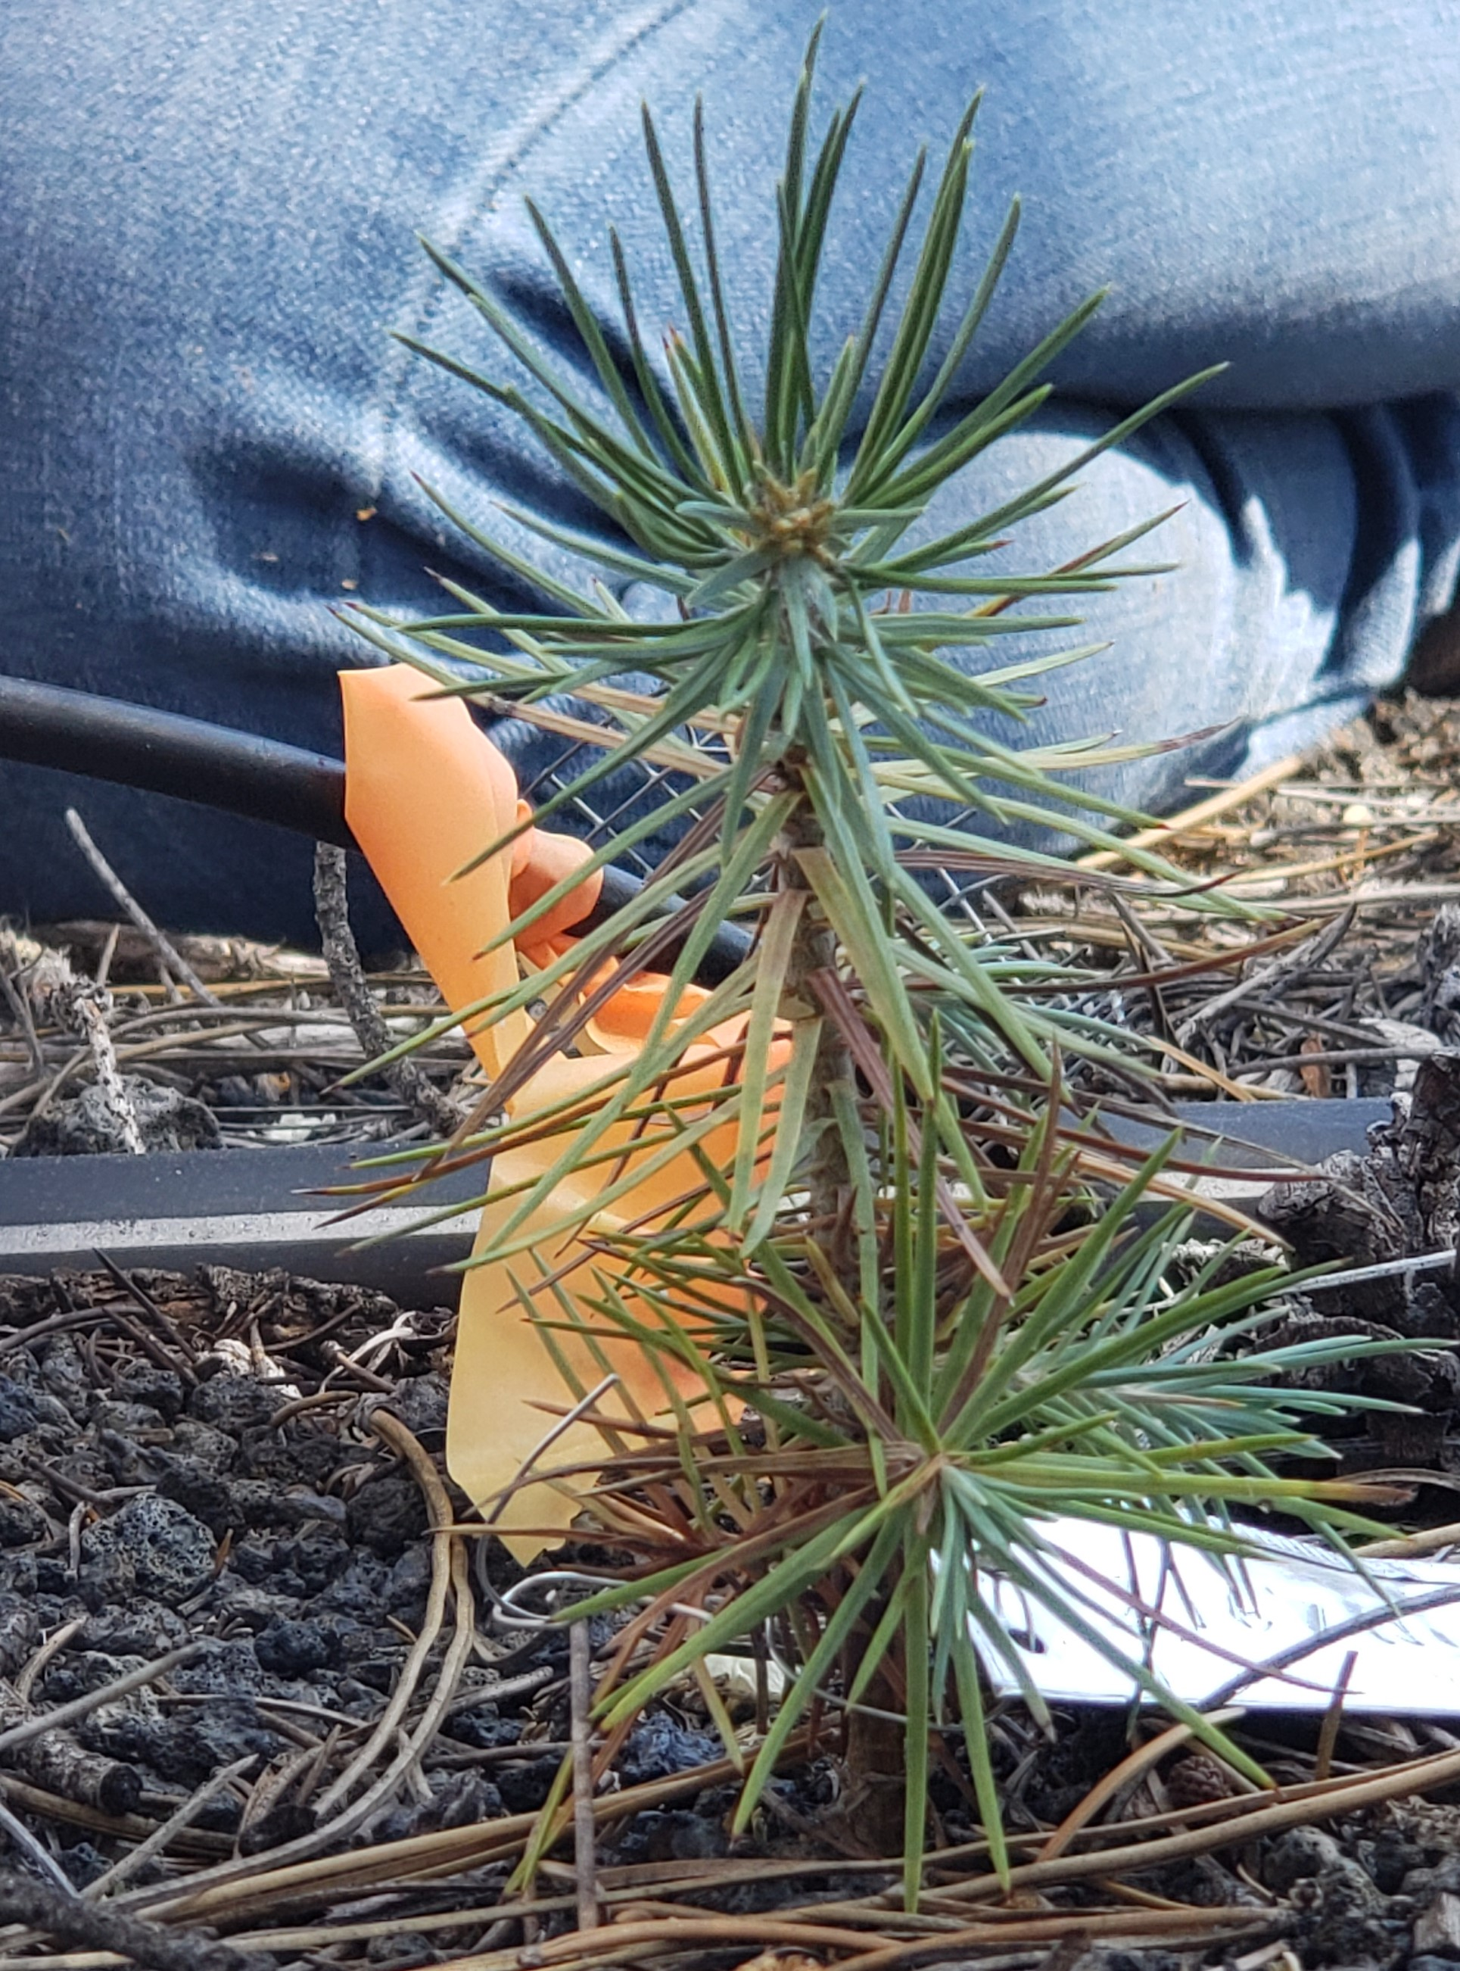
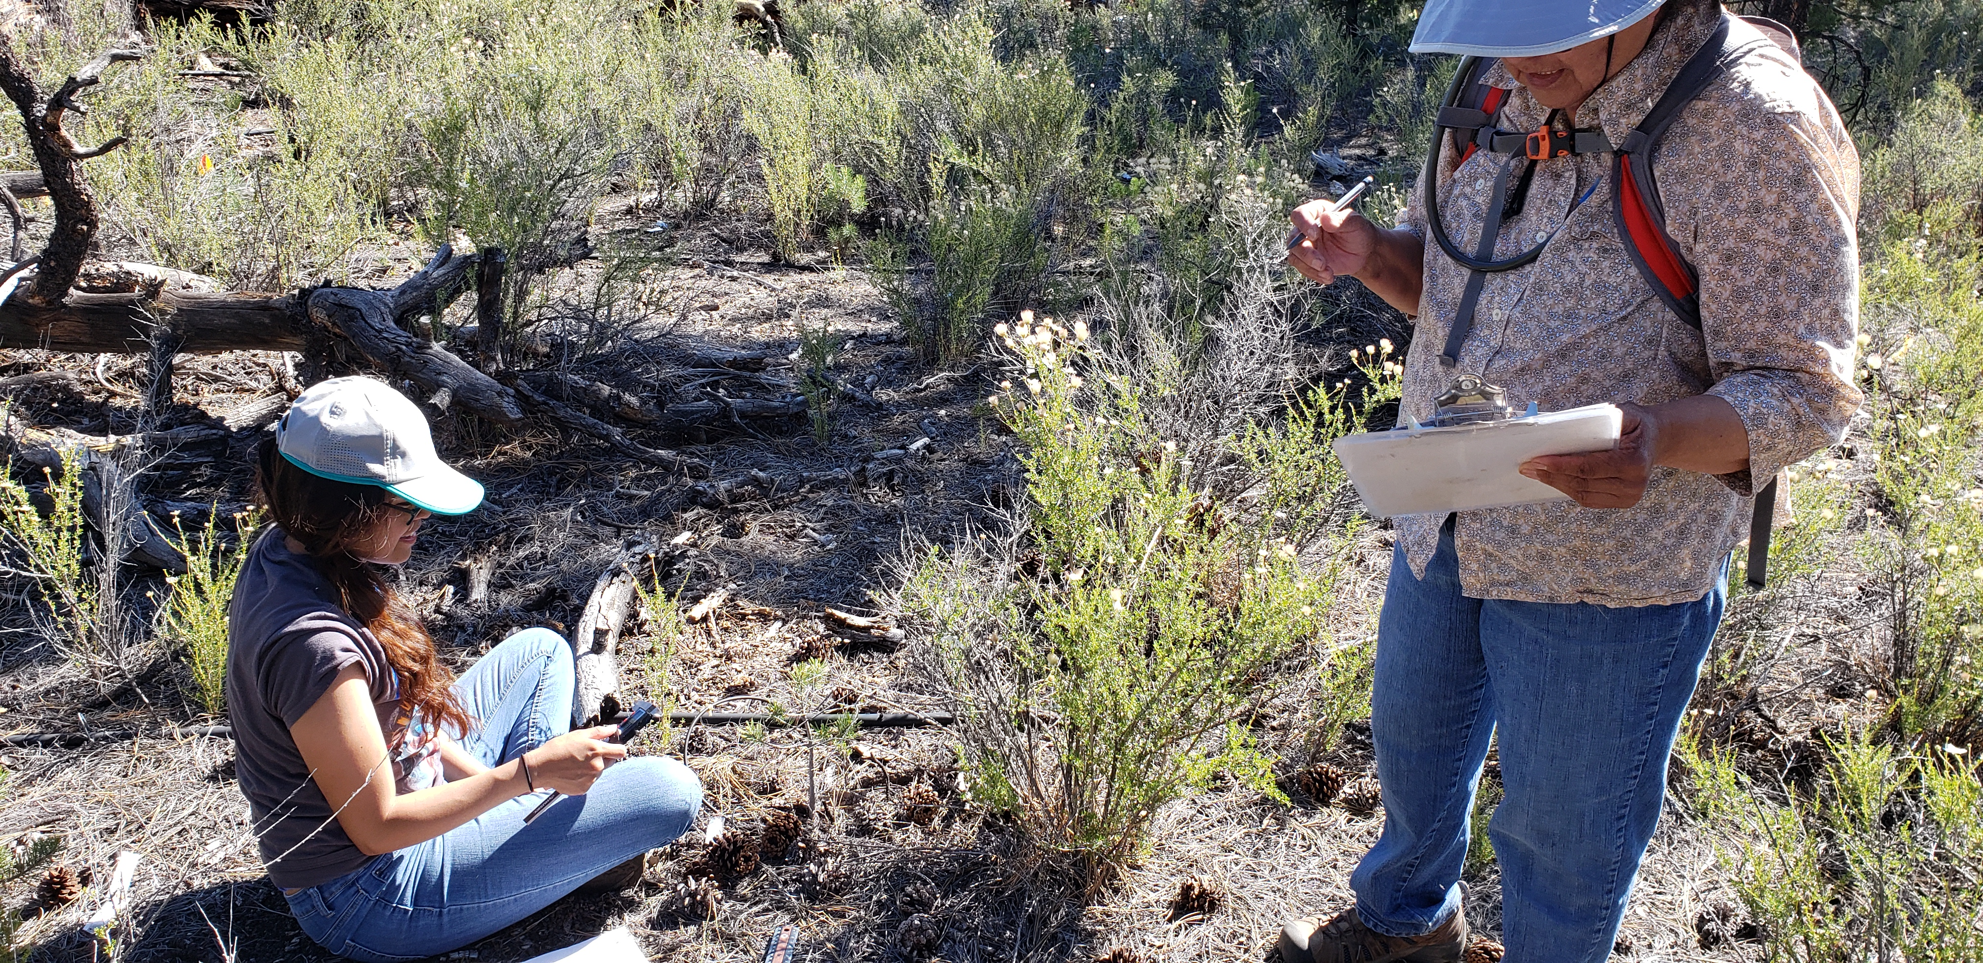
Common Garden Experiment to test effects of growing in cinder versus sandy soils
Common garden measurements were taken at cinder field site in Arizona and a sandy site in New Mexico.
Planting in common gardens enables us to see impacts of growth and survival differences due to the contrasting environment.
Seedling Data
Collection
Diameter Root Crown at base of seedling & Height
Notes:
Common garden measurements were taken at cinder field site in Arizona and a sandy site in New Mexico.

Slide 5
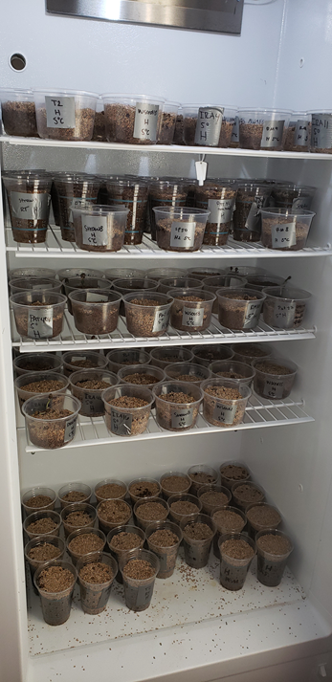
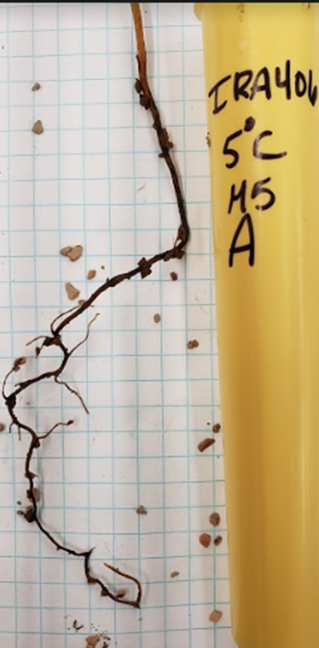
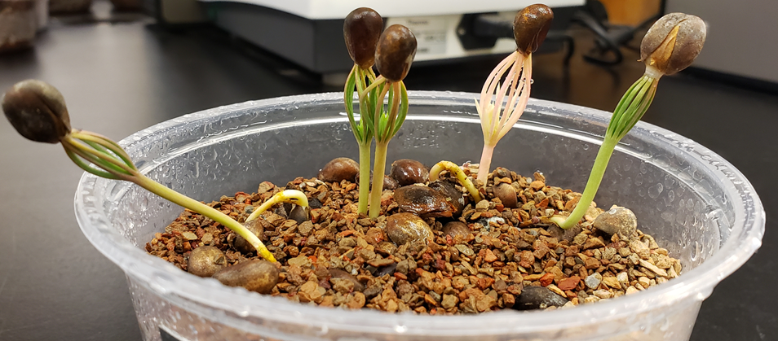
Growth Chamber experiment to test temperature effects and examine below ground traits
Pinyon pine seeds were germinated in a lab at high and medium temperatures.
Grown in simulated sandy loam mixture.
To test the temperature affects and examine below ground traits.
Roots photographed and measured using ImageJ and SmartRoot.
Notes:
Call it experiment to or growth chamber experiment. Talk about med vs hot germination conditions. Cinder vs non-cinder trees . Use the file with no win for new graphs.
Delete transplanted individually and the image cuz not doing it for this project.
Grown in simulated sandy loam soil.
2 different temperatues. Pre treatment= 5 C Room temp.
Medium and high germination temperatures.
Need analysis to see if temperature matters and will add to this slide if needed.
Delete pretreatment, add to test the temperature affects and examine below ground traits. Amy added

Slide 6
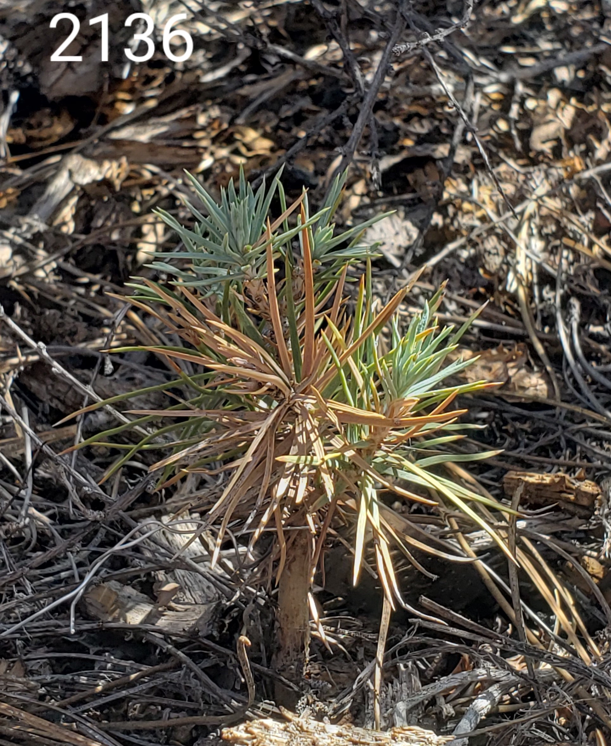
Cinder Field Garden has high drought mortality
Image taken in the field. Seedling showing signs of drought stress in it’s needles. Green needles = healthy, blue-green needles = drought stressed, and brown needles = dead needles.
Seedlings grown in the dryer cinder fields had higher mortality.
Notes:
Cinder garden site has higher mortality and fewer shoots.

Slide 7
Seedlings grown in the dry, cinder field common garden have significantly (p<0.05) larger diameter at root crown and longer shoots.
Notes:
Nned to ;\label the experiment 1 same as the previous
Instead of NAU and NTU make those into sandy soil, and cinder soil.
What verbiage to use → add text box, gives a summary of the slide of which are sig diff.
Seedlings grown in garden are sig shorter but with larger dcr and longer shoots. Sunset root surface sig diff for germ/temp and sunset root surface, but not length. Root vs. Volume has a fairly large sig different . Root v. diameter only affect is temperature and nothing to do with the site. Number of child roots, nothing. Child root density, nothing.
Make a figure of root volume and germ/temp vs site

Slide 8
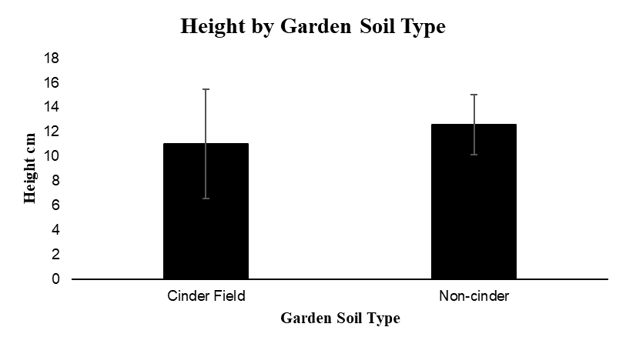
Seedlings grown in non-cinder soil common garden are taller and have more shoots per seedling

Slide 9
Results of Growth Chamber Experiment
Non-cinder seed sources make larger volume roots at high temperatures.
Cinder-field seeds sources do the opposite.
Conditional model:
Estimate Std. Error z value Pr (>|z|)
High temp. 1.2759 0.1388 9.195 <2e-16 ***
Medium temp. -0.1497 0.1324 -1.130 0.25827
Sunset V. location -0.1711 0.1893 -0.904 0.36597
Interaction between growth 0.4889 0.1741 2.808 0.00499**
temperature and soil type
Notes:
Don’t say method use growth chamber exp. Or exp 2.

Slide 10
Conclusions
Course cinder soils result in high seedling mortality even though this is not the case for adult trees.
In dry, cinder soil seedings have greater diameter at root collar, longer shoots, are shorter, and have fewer shoots. -–Future work could determine if this trait allocation is optimal for surviving drought.
Our results were surprising in that cinder seed source did not always grow more root, under warm conditions the non-cinder site grew more root.
This study needs to further investigate how survival and performance in seedlings and adult pinyon pine trees differ in allocation of limited resources in dry conditions and variable temperatures.
Notes:
Summarize, include a recap of the results, and seedling survival contrast with adult surviver at the cinder sites. We need to investigate how survival and performance in seedlings and adults.
Need from Amy need the image and root results.
NTU NAU shared drive → photos 2018 → Crown point Garden looks like sunset but its sand instead of cinder Add to new slide after Slide 3.
GÖRAN I. ÅGREN, OSKAR FRANKLIN, Root : Shoot Ratios, Optimization and Nitrogen Productivity, Annals of Botany, Volume 92, Issue 6, December 2003, Pages 795–800, https://doi.org/10.1093/aob/mcg203

Slide 11





Acknowledgements: I would like to thank my fellow research collaborators and institutions that have provided funding, guidance and support throughout this project:
Amy V. Whipple, Catherine A. Gehring, Paul Heinrich, Paloma Rose Davidson, Nadine Barlow, Dalyna L. Hannah, Ehren Reid Von Moler, Adair Patterson, Jared Karl Swenson, Isabella Carolyn Mejia, Hannah Rea Kantoris, Department of Astronomy and Planetary Science at Northern Arizona University, Arizona Space Grant Consortium, Arizona State University, NASA, Navajo Technical University.

